Slide 1
CAPSTONE AUTOMATION
Name: Priyanka Ghosh
JAVA SELENIUM BATCH 3
Technical Strengths:
Strong in Web Application Automation using Selenium WebDriver and Java
Expertise in CI/CD integration using Jenkins and Version Control with GitHub

Slide 2
Saucedemo Webapplication
Our Capstone Project focused on developing a robust automated testing framework for a web application (https://www.saucedemo.com). The goal was to automate functional testing, integrate the test framework into a CI/CD pipeline, and ensure continuous validation of application stability.

Slide 3
Type of Testing & Tools Used
Type of Testing:
Manual Testing
Automation Testing with CI/CD integration
Tools Used:
Selenium WebDriver
TestNG
Cucumber (BDD Framework)
Maven (Build and Dependency Management)

Slide 4
Type of Testing & Tools Used
GitHub (Version Control)
Jenkins (CI/CD Automation)
JIRA (Requirement & Defect Management)
Extent Reports (HTML Reporting)

Slide 5
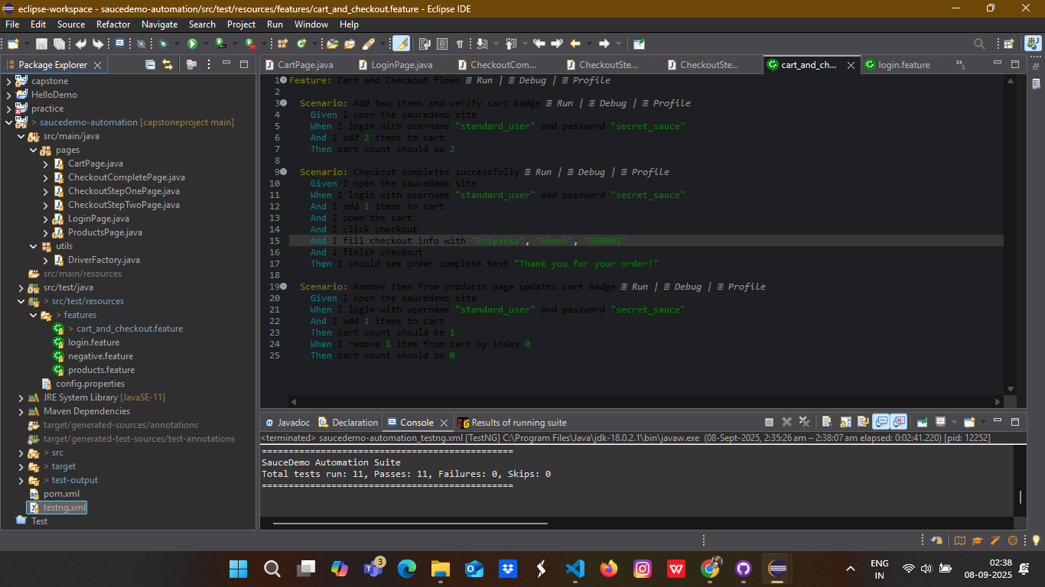
Automation framework Screenshot from Eclipse

Slide 6
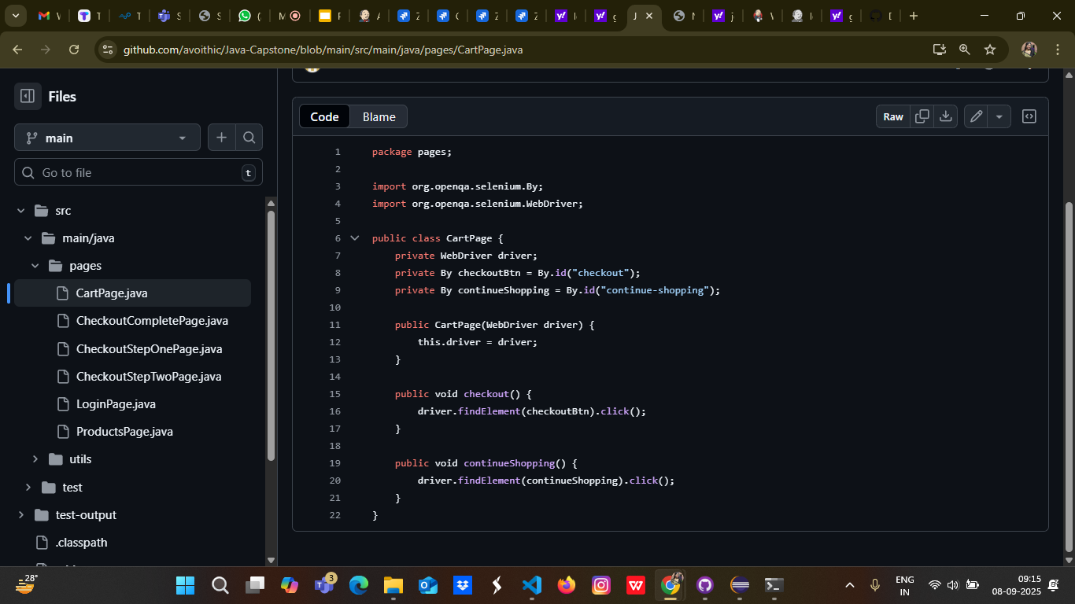
Automation framework Screenshot from Gitrepo

Slide 7
Automation Approach
Page Object Model (POM): Organized classes for each web page for reusability and maintainability
Data-Driven Testing: Test data stored in Excel sheets and Properties files for flexible test execution
Cross-Browser Testing: Executed tests on Chrome and Firefox browsers
Maven Build System: Managed dependencies and build configurations
Java & SQL: Java programming language for scripting, SQL for database validation

Slide 8
Work Description
Developed automation scripts using Selenium WebDriver + TestNG + Cucumber
Implemented integration with Jenkins for automated test execution on each code commit
Managed requirements and test cases in JIRA with active tracking of tasks and bugs
Produced detailed HTML reports with screenshots on test failure using ExtentReports
Conducted manual testing using Zphyr Board in JIRA for Sprint backlog management

Slide 9
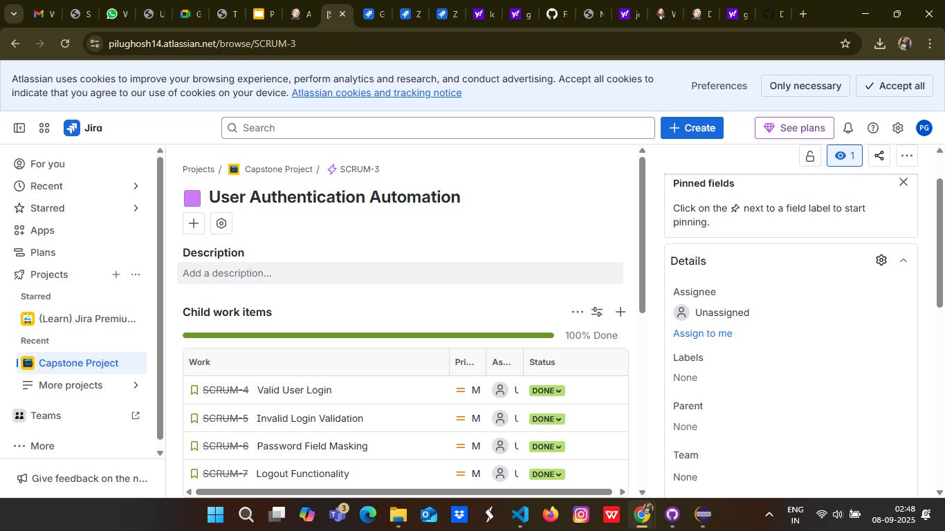
JiRA backlog screenshot and description one line to show Agile work in sprint

Slide 10
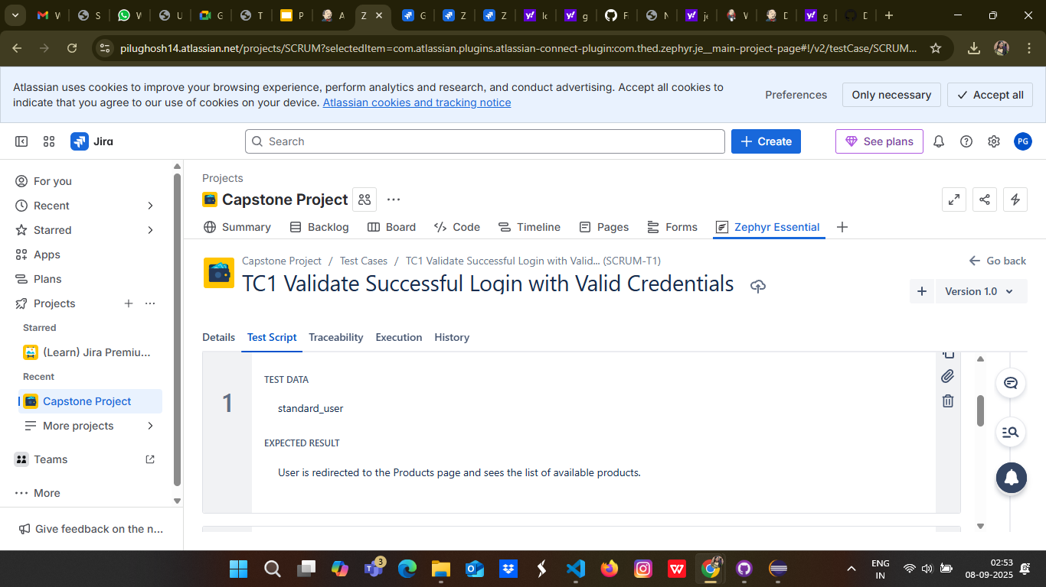
Zphyre Board Smoke , Sanity, Regression Test case

Slide 11
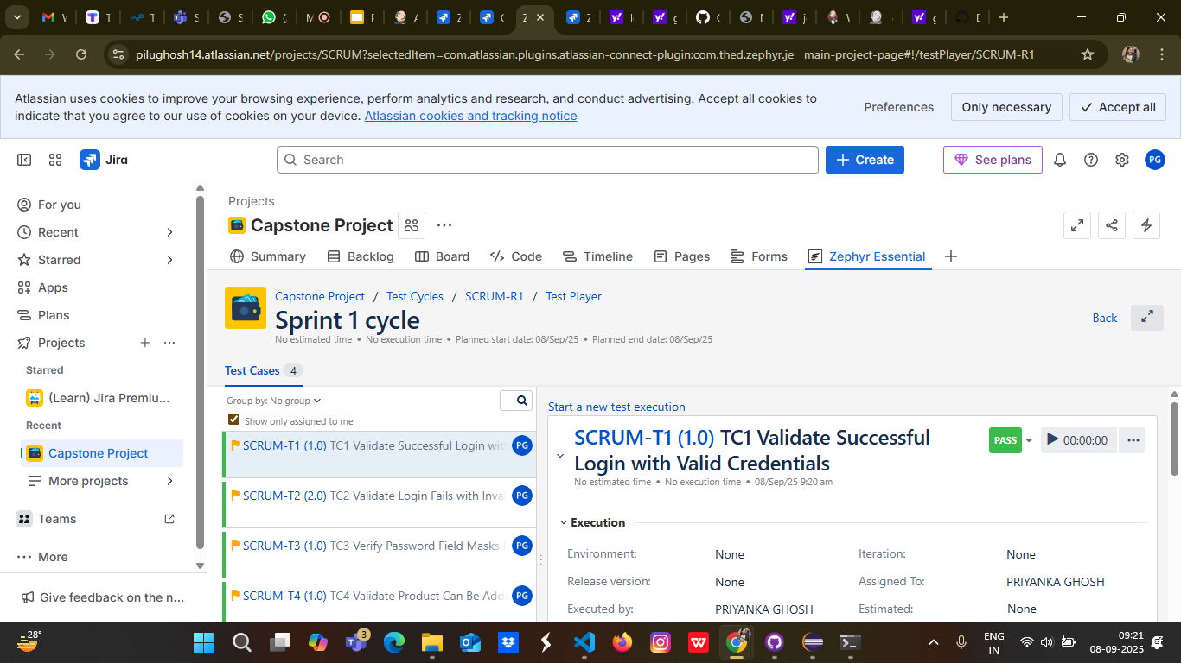
Test report from Zphyr screenshot

Slide 12
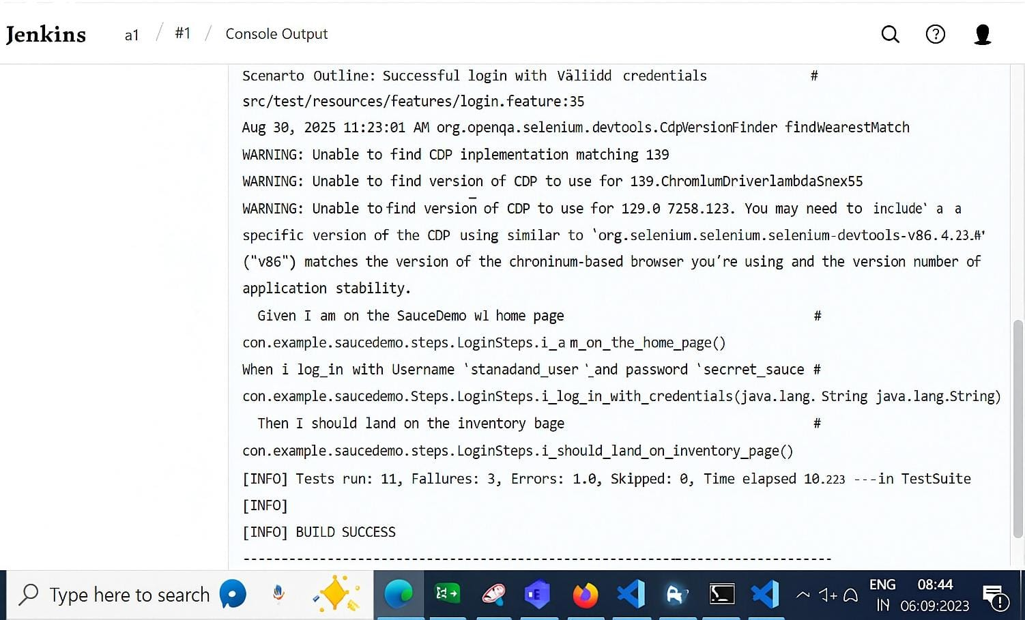
Jenkins Screenshot

Slide 13
Thanak you

